Slide 1
CS276: Information Retrieval and Web Search
Christopher Manning and Pandu Nayak
Lecture 15: Distributed Word Representations for Information Retrieval
Notes:
13 slides for IR part at end, so allow 15 mins for that. Cut off GloVe as needed!

Slide 2
How can we more robustly match a user’s search intent?
Sec. 9.2.2
We want to understand the query, not just do String equals()
If user searches for [Dell notebook battery size], we would like to match documents discussing “Dell laptop battery capacity”
If user searches for [Seattle motel], we would like to match documents containing “Seattle hotel”
A naïve information retrieval system does nothing to help
Simple facilities that we have already discussed do a bit to help
Spelling correction
Stemming / case folding
But we’d like to better understand when query/document match

Slide 3
How can we more robustly match a user’s search intent?
Sec. 9.2.2
Use of anchor text may solve this by providing human authored synonyms, but not for new or less popular web pages, or non-hyperlinked collections
Relevance feedback could allow us to capture this if we get near enough to matching documents with these words
We can also fix this with information on word similarities:
A manual thesaurus of synonyms
A measure of word similarity
Calculated from a big document collection
Calculated by query log mining (common on the web)

Slide 4
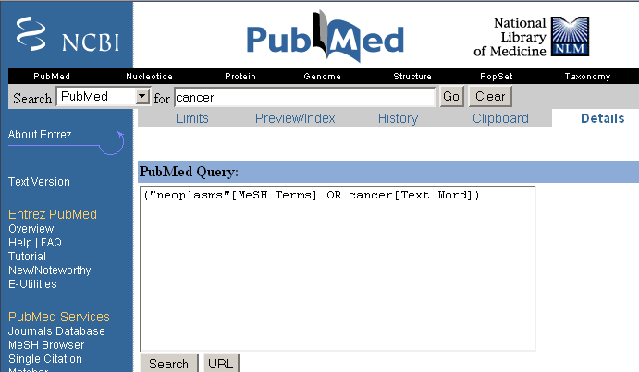
Example of manual thesaurus
Sec. 9.2.2
Notes:
E.g. MedLine: physician, syn: doc, doctor, MD, medico

Slide 5
Thesaurus-based query expansion
Sec. 9.2.2
For each term t in a query, expand the query with synonyms and related words of t from the thesaurus
feline → feline cat
May weight added terms less than original query terms.
Generally increases recall
Widely used in many science/engineering fields
May significantly decrease precision, particularly with ambiguous terms.
“interest rate” → “interest rate fascinate evaluate”
There is a high cost of manually producing a thesaurus
And for updating it for scientific changes

Slide 6
Search log query expansion
Context-free query expansion ends up problematic
[light hair] ≈ [fair hair] At least in U.K./Australia? ≈ blonde
So expand [light] ⇒ [light fair]
But [bed light price] ≠ [bed fair price]
You can learn query context-specific rewritings from search logs by attempting to identify the same user making a second attempt at the same user need
[Hinton word vector]
[Hinton word embedding]
In this context, [vector] ≈ [embedding]
But not when talking about a disease vector or C++!

Slide 7
Automatic Thesaurus Generation
Sec. 9.2.3
Attempt to generate a thesaurus automatically by analyzing a collection of documents
Fundamental notion: similarity between two words
Definition 1: Two words are similar if they co-occur with similar words.
Definition 2: Two words are similar if they occur in a given grammatical relation with the same words.
You can harvest, peel, eat, prepare, etc. apples and pears, so apples and pears must be similar.
Co-occurrence based is more robust, grammatical relations are more accurate.
Why?

Slide 8
Co-occurrence Thesaurus
Sec. 9.2.3
Simplest way to compute one is based on term-term similarities in C = AA^{T} where A is term-document matrix.
w_{i,j} = (normalized) weight for (t_{i} ,d_{j})
For each t_{i}, pick terms with high values in C
d_{j}
N
A
What does C contain if A is a term-doc incidence (0/1) matrix?
t_{i}
M

Slide 9
Automatic thesaurus generation example
Word | Nearest neighbors
absolutely | absurd, whatsoever, totally, exactly, nothing
bottomed | dip, copper, drops, topped, slide, trimmed
captivating | shimmer, stunningly, superbly, plucky, witty
doghouse | dog, porch, crawling, beside, downstairs
makeup | repellent, lotion, glossy, sunscreen, skin, gel
mediating | reconciliation, negotiate, cease, conciliation
keeping | hoping, bring, wiping, could, some, would
lithographs | drawings, Picasso, Dali, sculptures, Gauguin
pathogens | toxins, bacteria, organisms, bacterial, parasites
senses | grasp, psyche, truly, clumsy, naïve, innate

Slide 10
Automatic Thesaurus Generation Issues
Sec. 9.2.3
Quality of associations is usually a problem
Sparsity
Term ambiguity may introduce irrelevant statistically correlated terms.
“planet earth facts” → “planet earth soil ground facts”
Since terms are highly correlated anyway, expansion may not retrieve many additional documents.
100,000
C
10¹⁰ entries
100,000

Slide 11
Can you directly learn term relations?
Basic IR is scoring on q^{T}d
No treatment of synonyms; no machine learning
Can we learn parameters W to rank via q^{T}Wd
Problem is again sparsity – W is huge > 10¹⁰

Slide 12
How can we represent term relations?
Sec. 9.2.2
With the standard symbolic encoding of terms, each term is a dimension
Different terms have no inherent similarity
motel [0 0 0 0 0 0 0 0 0 0 1 0 0 0 0]^{T} hotel [0 0 0 0 0 0 0 3 0 0 0 0 0 0 0] = 0
If query on hotel and document has motel, then our query and document vectors are orthogonal

Slide 13
Is there a better way?
Idea:
Can we learn a low dimensional representation of a word in ℝ^{d} such that dot products u^{T}v express word similarity?
We could still if we want to include a “translation” matrix between vocabularies (e.g., cross-language): u^{T}Wv
But now W is small!
Supervised Semantic Indexing (Bai et al. Journal of Information Retrieval 2009) shows successful use of learning W for information retrieval
But we’ll develop direct similarity in this class

Slide 14
Distributional similarity based representations
You can get a lot of value by representing a word by means of its neighbors
“You shall know a word by the company it keeps”
(J. R. Firth 1957: 11)
One of the most successful ideas of modern statistical NLP
government debt problems turning into banking crises as has happened in
saying that Europe needs unified banking regulation to replace the hodgepodge
 These words will represent banking 
Notes:
You can vary whether you use local or large context to get a more syntactic or semantic clustering

Slide 15
Solution: Low dimensional vectors
The number of topics that people talk about is small (in some sense)
Clothes, movies, politics, …
Idea: store “most” of the important information in a fixed, small number of dimensions: a dense vector
Usually 25 – 1000 dimensions
How to reduce the dimensionality?
Go from big, sparse co-occurrence count vector to low dimensional “word embedding”

Slide 16
Traditional Way: Latent Semantic Indexing/Analysis
Sec. 18.2
Use Singular Value Decomposition (SVD) – kind of like Principal Components Analysis (PCA) for an arbitrary rectangular matrix – or just random projection to find a low-dimensional basis
Theory is that similarity is preserved as much as possible
Weakly, you can actually gain in IR by doing LSA as “noise” of term variation gets replaced by semantic “concepts”
Popular in the 1990s [Deerwester et al. 1990, etc.]
Results were always somewhat iffy (… it worked sometimes)
Harder to implement efficiently in an IR system (dense vectors!)
Discussed in IIR chapter 18, but not discussed further here
And not on the exam (!)

Slide 17
“Neural Embeddings”

Slide 18
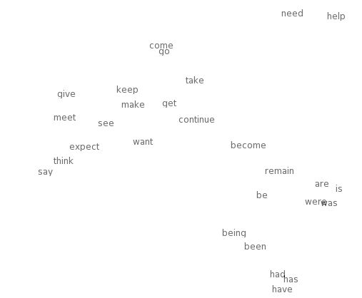

Neural word embeddings - visualization
Notes:
Let’s look at the idea of word vectors in a bit more detail before we describe our model.
…Large clouds of words with similar parts of speech and the smaller regions with similar meaning.
Why would we prefer this representation? To answer this question, let’s consider a commonly used alternative which is to represent words as an index into a vocabulary.

Slide 19
Idea: Directly learn low-dimensional word vectors
Old idea. Relevant for this lecture & deep learning:
Learning representations by back-propagating errors. (Rumelhart et al., 1986)
A neural probabilistic language model (Bengio et al., 2003)
NLP (almost) from Scratch (Collobert & Weston, 2008)
A recent, even simpler and faster model: word2vec (Mikolov et al. 2013) → intro now
Initial models were quite non-linear and slow; recent models have used fast, bilinear models

Slide 20
Main Idea of word2vec
Instead of capturing co-occurrence counts directly, predict surrounding words of every word
Faster and can easily incorporate a new sentence/document or add a word to the vocabulary
Two variants:
CBOW: Predict target from bag of words context
Skipgram: Predict context words from target (position-independent)
In general SGNS (Skipgram, Negative Sampling) has ended up preferred but we’ll look at CBOW, as our IR paper uses it….

Slide 21
CBOW (Continuous Bag of Words)
CBOW learns a word embedding by maximizing the log conditional probability of a word given the bag of context words occurring within a fixed-sized window around that word.

Slide 22
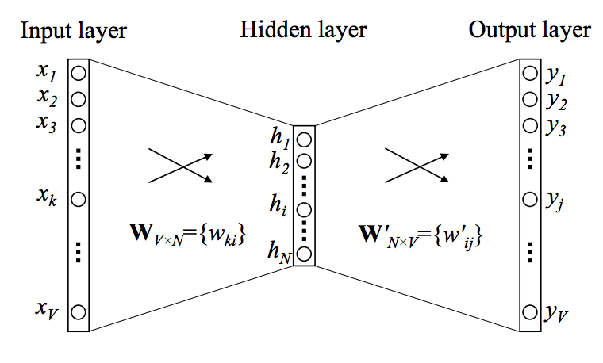
Details of 1 word context CBOW
Objective function: Maximize the log probability of a target word given a context word
Attempts
to predict
one-hot
vector
One-hot
vector
These matrices have word vectors!

Slide 23
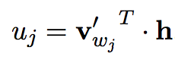
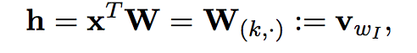
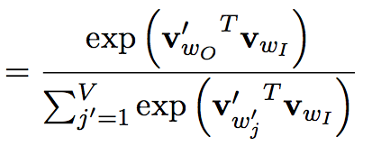
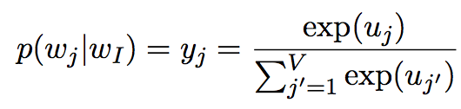
CBOW model (one context word)
Word
score
Notes:
h just copies row of W – word embedding from one hot x.
Different output matrix. Scoure u_j for each word
v’_w_j is the jth column of the matrix W’
Get jth column of the matrix W’. Dot product is similarity. Then softmax model!
Two representations of the word w.

Slide 24
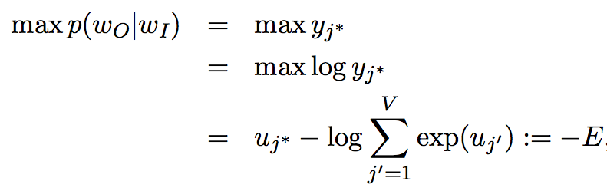
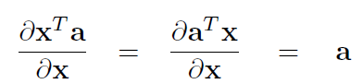
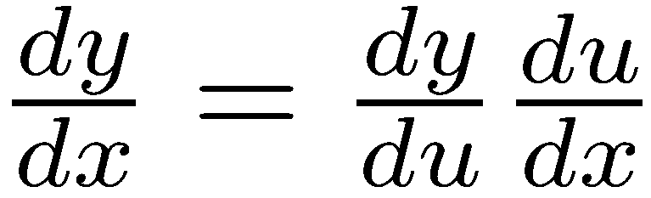
CBOW model
Want to
maximize
Do this by differentiating wrt each variable and walking downhill to minimize E. Remember:
Chain rule: If y = f(u) and u = g(x), i.e. y=f(g(x)), then:
Notes:
y_j* is actual word observed.
cross entropy loss E. Loss function negates
Derivative is prediction error.

Slide 25
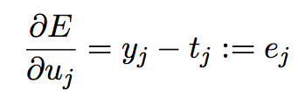
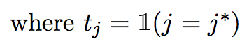
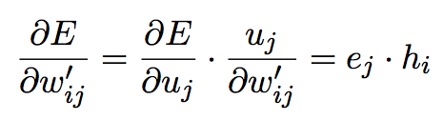
CBOW model
Want to
maximize
Notes:
y_j* is actual word observed.
cross entropy loss E. Loss function negates
Derivative is prediction error.

Slide 26
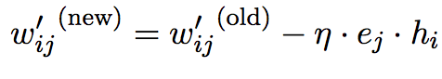
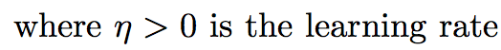
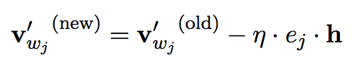
CBOW model: Stochastic gradient descent (SGD) updates
These are the standard form of SGD updates. You nudge each parameter a little in the negative direction of gradient to go downhill towards the minimum
Notes:
cross entropy loss

Slide 27
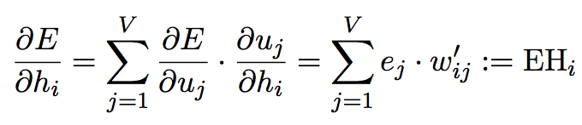
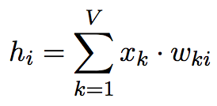
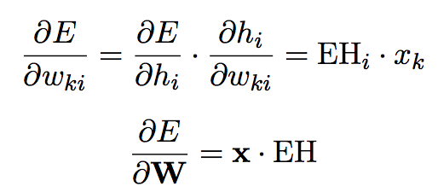
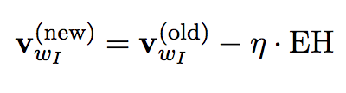
CBOW model: W matrix
Notes:
cross entropy loss

Slide 28
Training regime
Start with small, random vectors for words
Iteratively go through millions of words in contexts
Work out prediction, work out error
Backpropagate error to update word vectors
Repeat
Result is dense vectors for all words
linguistics =
0.286
0.792
−0.177
−0.107
0.109
−0.542
0.349
0.271

Slide 29
Linear Relationships in word2vec
These representations are very good at encoding similarity and dimensions of similarity!
Analogies testing dimensions of similarity can be solved quite well just by doing vector subtraction in the embedding space
Syntactically
x_{apple} − x_{apples} ≈ x_{car} − x_{cars} ≈ x_{family} − x_{families}
Similarly for verb and adjective morphological forms
Semantically (Semeval 2012 task 2)
x_{shirt} − x_{clothing} ≈ x_{chair} − x_{furniture}
x_{king} − x_{man} ≈ x_{queen} − x_{woman}

Slide 30
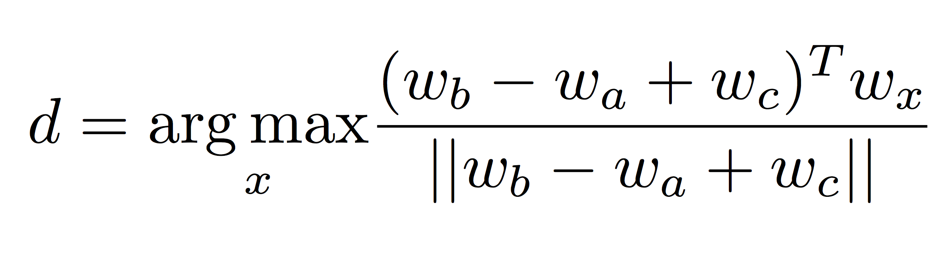
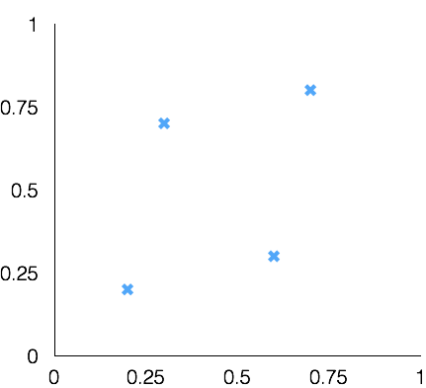
Word Analogies
Test for linear relationships, examined by Mikolov et al.
a:b :: c:?
a:b :: c:?
man:woman :: king:?
+
king
[ 0.30 0.70 ]
queen
king
−
man
[ 0.20 0.20 ]
+
woman
[ 0.60 0.30 ]
woman
queen
[ 0.70 0.80 ]
man

Slide 31
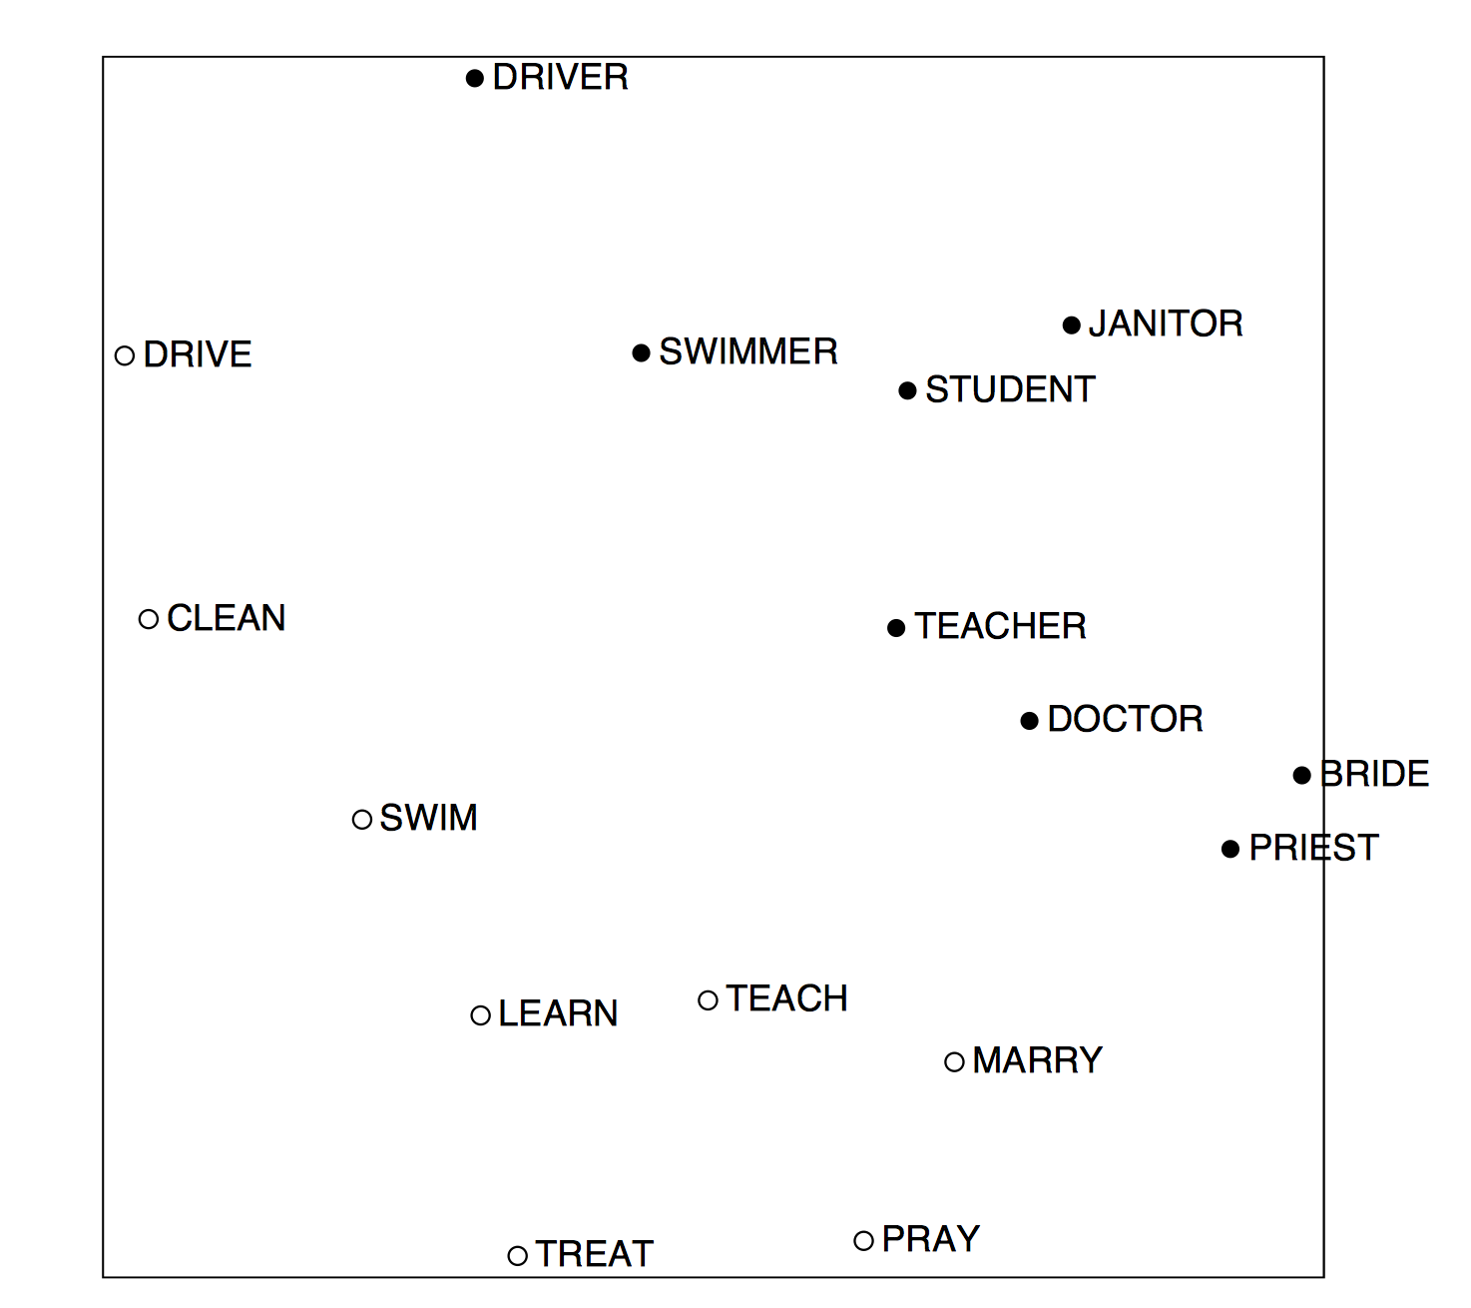
COALS model (count-modified LSA) [Rohde, Gonnerman & Plaut, ms., 2005]

Slide 32
Count based vs. direct prediction
LSA, HAL (Lund & Burgess), COALS (Rohde et al), Hellinger-PCA (Lebret & Collobert)
NNLM, HLBL, RNN, word2vec Skip-gram/CBOW, (Bengio et al; Collobert & Weston; Huang et al; Mnih & Hinton; Mikolov et al; Mnih & Kavukcuoglu)
Fast training
Scales with corpus size
Efficient usage of statistics
Inefficient usage of statistics
Primarily used to capture word similarity
Generate improved performance on other tasks
Disproportionate importance given to small counts
Can capture complex patterns beyond word similarity

Slide 33
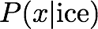
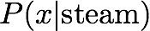
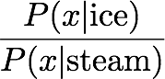
Encoding meaning in vector differences [Pennington, Socher, and Manning, EMNLP 2014]
Crucial insight:
Ratios of co-occurrence probabilities can encode meaning components
x = solid
x = gas
x = water
x = random
large
small
large
small
small
large
large
small
large
small
~1
~1

Slide 34
Encoding meaning in vector differences [Pennington, Socher, and Manning, EMNLP 2014]
Crucial insight:
Ratios of co-occurrence probabilities can encode meaning components
x = solid
x = gas
x = water
x = fashion
1.9 x 10⁻⁴
6.6 x 10⁻⁵
3.0 x 10⁻³
1.7 x 10⁻⁵
2.2 x 10⁻⁵
7.8 x 10⁻⁴
2.2 x 10⁻³
1.8 x 10⁻⁵
8.9
8.5 x 10⁻²
1.36
0.96

Slide 35

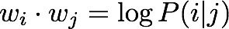
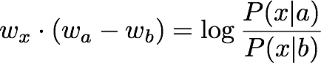
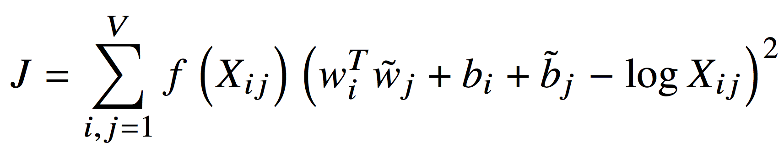
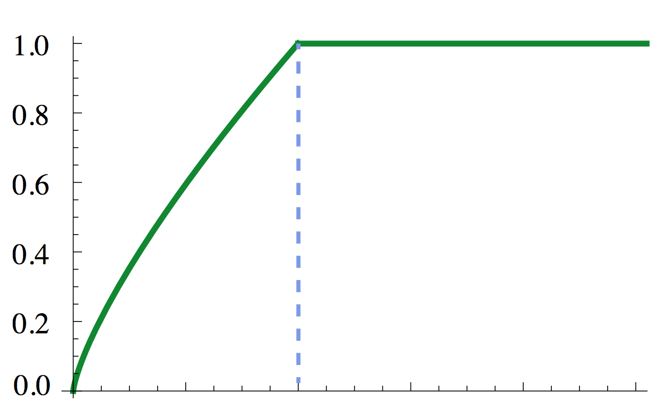
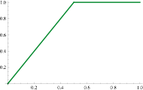

GloVe: A new model for learning word representations [Pennington, Socher, and Manning, EMNLP 2014]
Notes:
Q: How can we capture this in a word vector space?
A: Log-bilinear model
Fast training
Scalable to huge corpora
Good performance even with small corpus, and small vectors

Slide 36
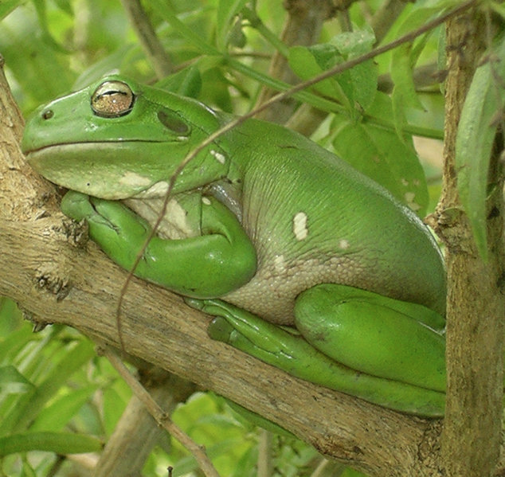
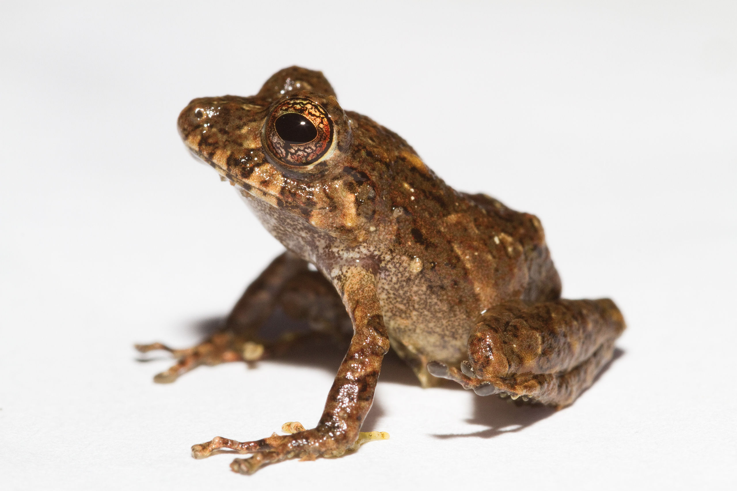
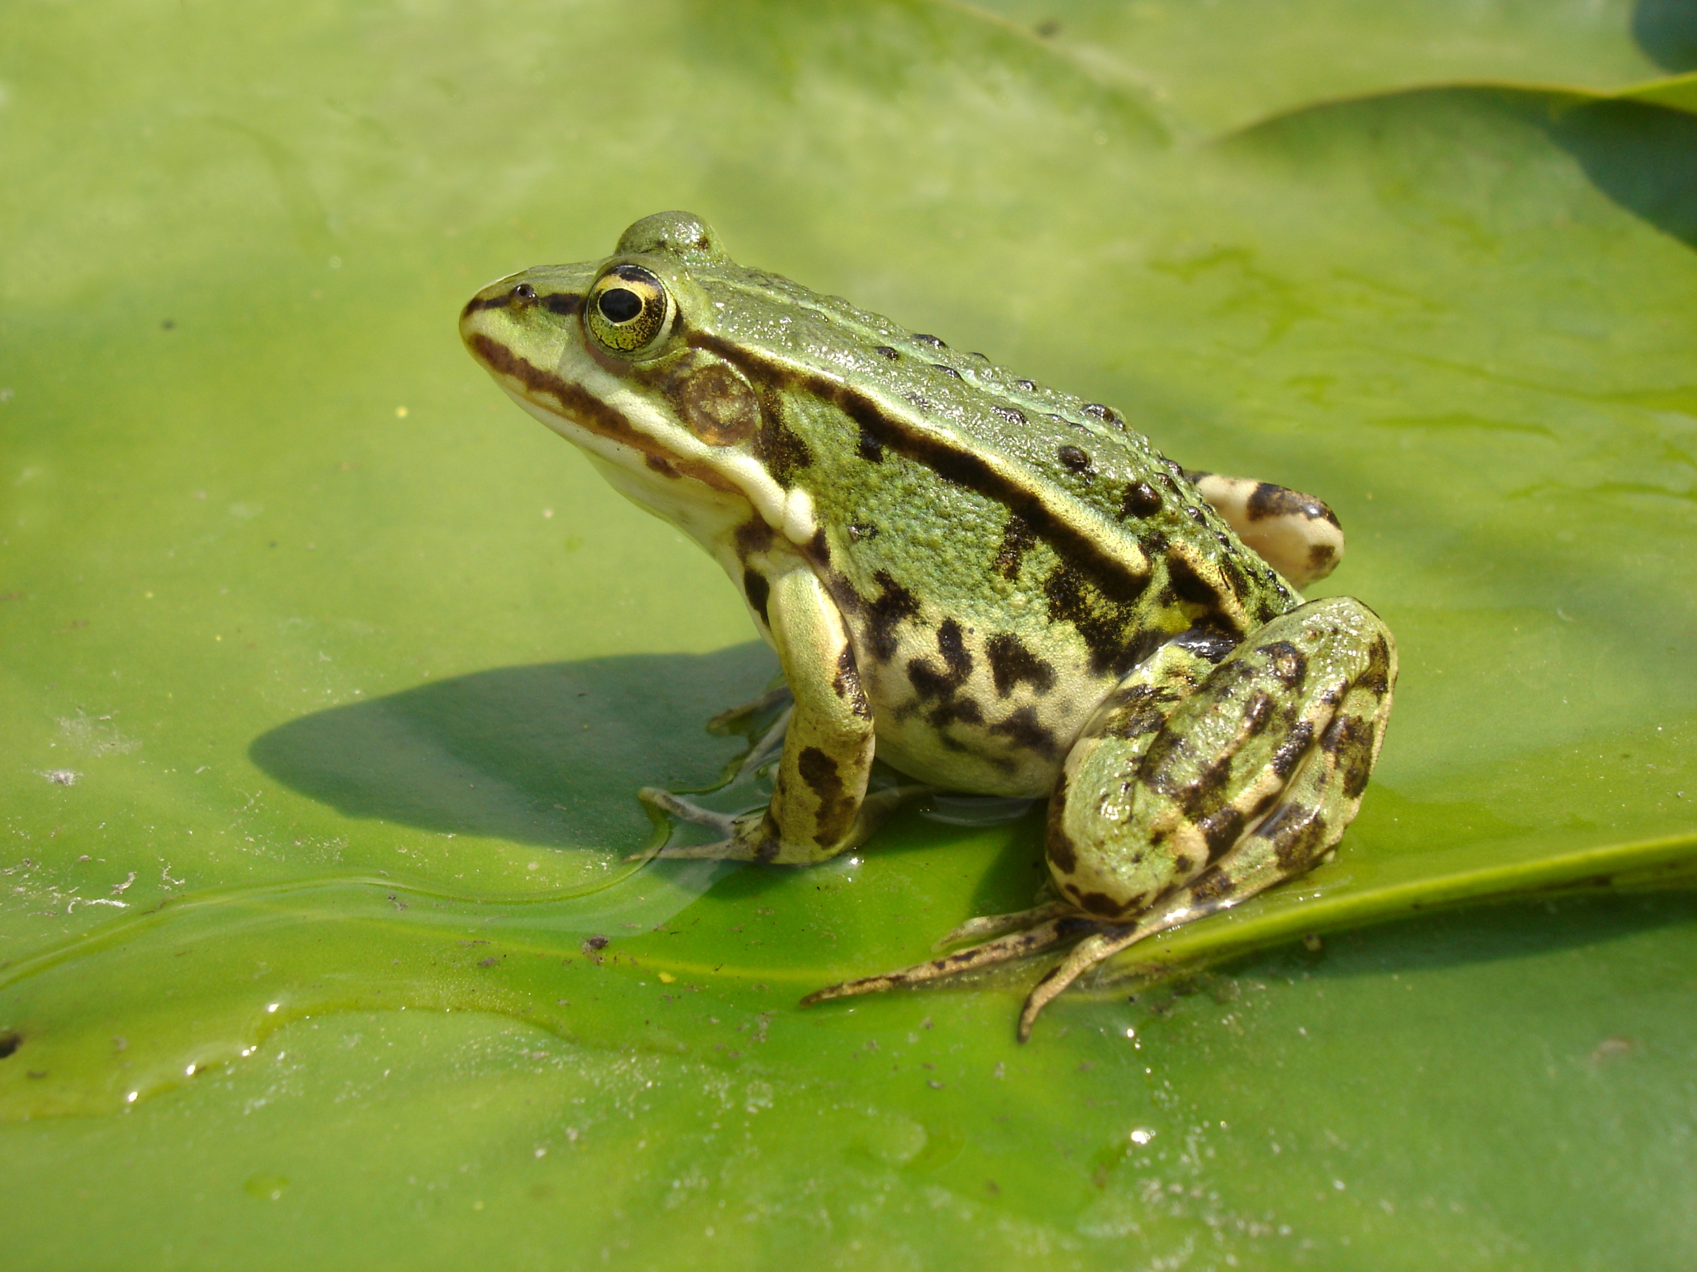
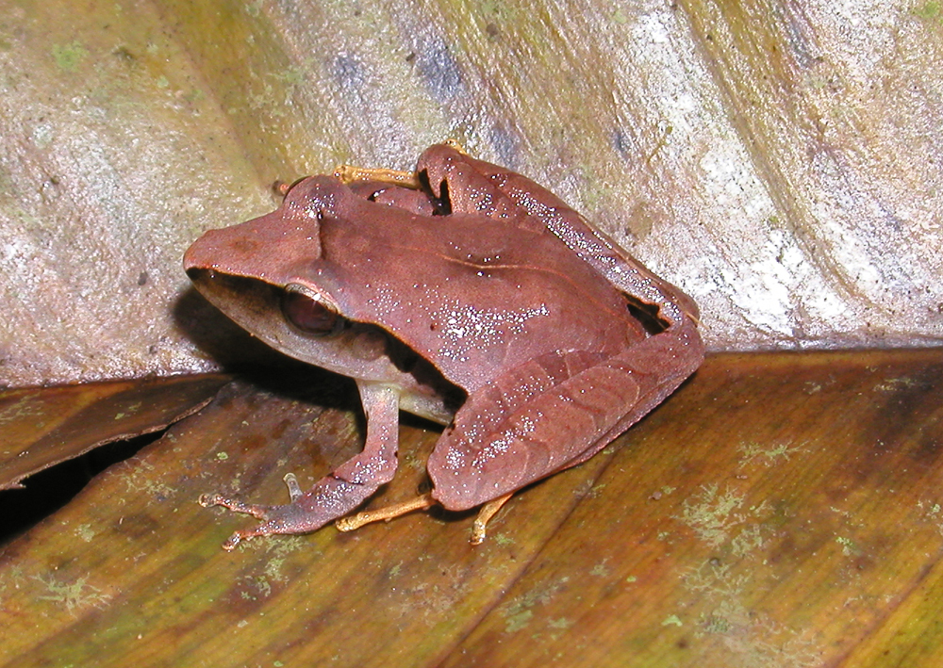
Word similarities
Nearest words to frog:
1. frogs
2. toad
3. litoria
4. leptodactylidae
5. rana
6. lizard
7. eleutherodactylus
litoria
leptodactylidae
rana
eleutherodactylus
http://nlp.stanford.edu/projects/glove/

Slide 37
Word analogy task [Mikolov, Yih & Zweig 2013a]
Model | Dimensions | Corpus size | Performance (Syn + Sem)
CBOW (Mikolov et al. 2013b) | 300 | 1.6 billion | 36.1
GloVe (this work) | 300 | 1.6 billion | 70.3
CBOW (M et al. 2013b, by us) | 300 | 6 billion | 65.7
GloVe (this work) | 300 | 6 billion | 71.7
CBOW (Mikolov et al. 2013b) | 1000 | 6 billion | 63.7
GloVe (this work) | 300 | 42 billion | 75.0
Notes:
Capturing attributes of meaning through a word analogy task

Slide 38
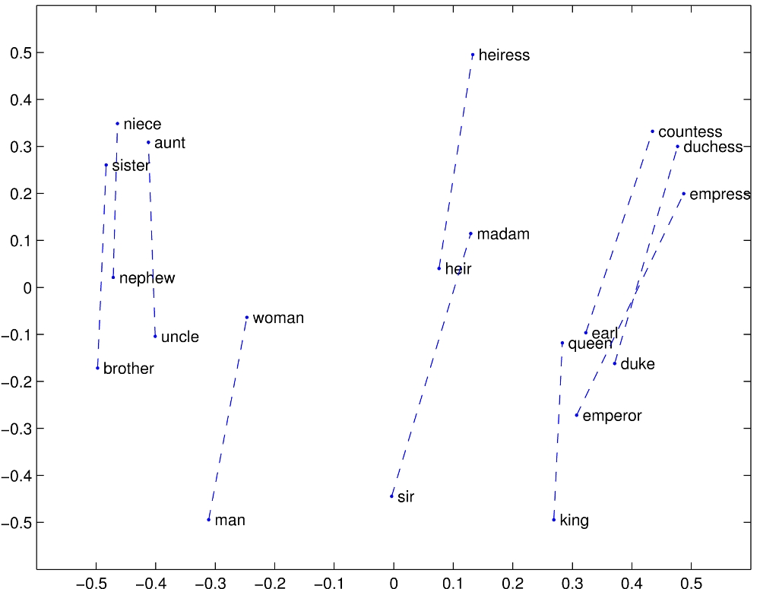
GloVe Visualizations
http://nlp.stanford.edu/projects/glove/

Slide 39
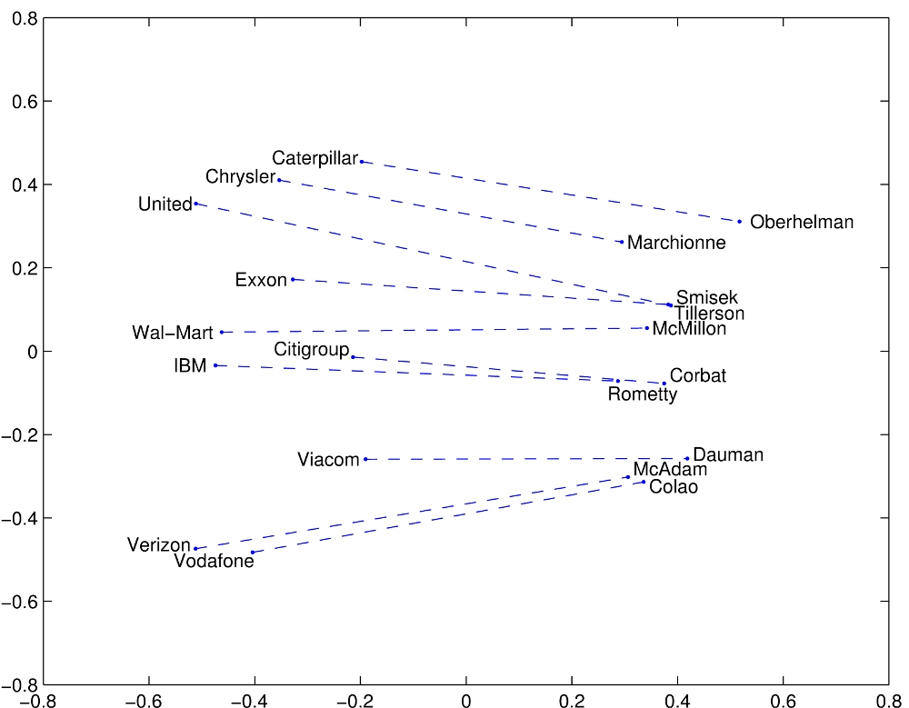
Glove Visualizations: Company - CEO

Slide 40
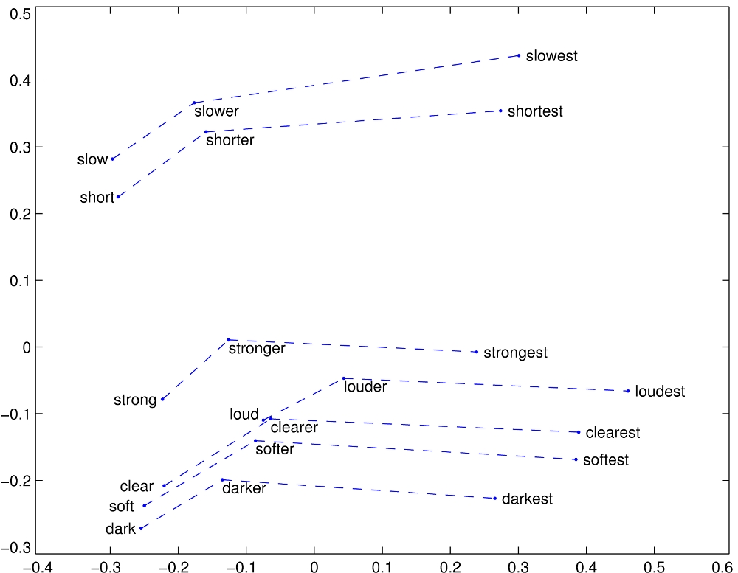
Glove Visualizations: Superlatives

Slide 41

Application to Information Retrieval
Application is just beginning – there’s almost nothing to go on
Google’s RankBrain – almost nothing is publicly known
Bloomberg article by Jack Clark (Oct 26, 2015): http://www.bloomberg.com/news/articles/2015-10-26/google-turning-its-lucrative-web-search-over-to-ai-machines
SIGIR workshop this summer!
Early paper from Bing seems most interesting for now
Notes:
Remember also RankNet for learning to rank – but here we are interested in neural distributed representations of words.

Slide 42
An application to information retrieval
Nalisnick, Mitra, Craswell & Caruana. 2016. Improving Document Ranking with Dual Word Embeddings. WWW 2016 Companion. http://research.microsoft.com/pubs/260867/pp1291-Nalisnick.pdf
Mitra, Nalisnick, Craswell & Caruana. 2016. A Dual Embedding Space Model for Document Ranking. arXiv:1602.01137 [cs.IR]
Builds on BM25 model idea of “aboutness”
Not just term repetition indicating aboutness
Relationship between query terms and all terms in the document indicates aboutness (BM25 uses only query terms)
Makes clever argument for different use of word and context vectors in word2vec’s CBOW/SGNS or GloVe
Notes:
People at/working with Bing.
Probably not the definitive paper. But it exists today?

Slide 43
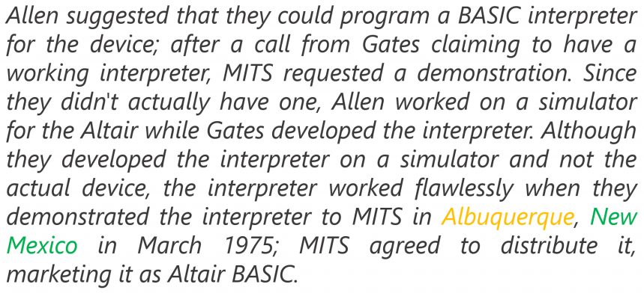
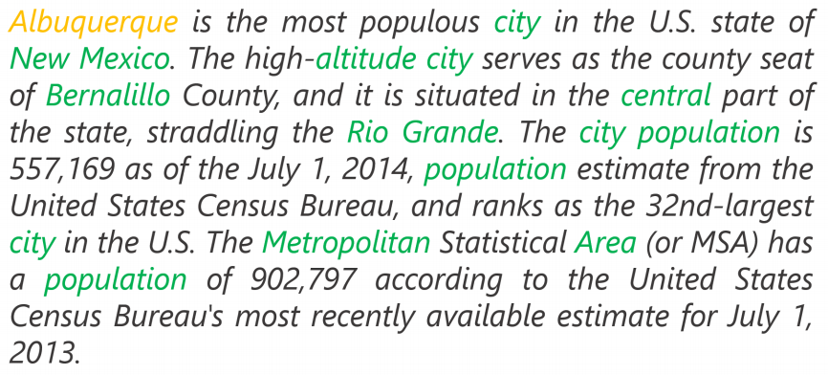
Modeling document aboutness: Results from a search for Albuquerque
d₁
d₂
Notes:
Both documents have 1 occurrence of the search term, but d2 has a lot more words that commonly co-occur with the search term. This is strong evidence that it is about the search term.

Slide 44
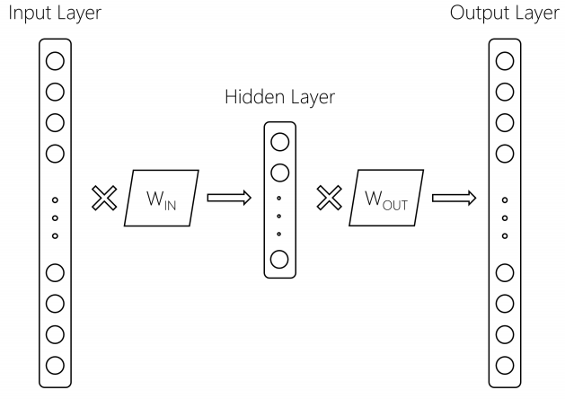
Using 2 word embeddings
CBOW model with 1 word of context
W_{IN} Embeddings
for context
words
W_{OUT} Embeddings
for focus
words
Context word
Focus word
We can gain by using these two embeddings differently
Notes:
Current exploitation is usually:
Just throw the context embeddings away (word2vec) – or paper says it always uses Win, which would be funnier but may be true.
Average them (GloVe) – gave gains

Slide 45
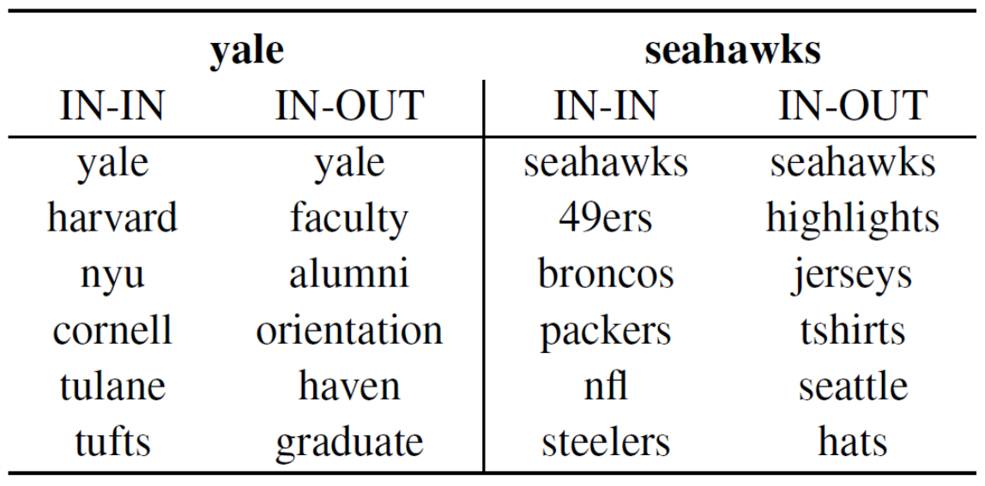
Using 2 word embeddings
Notes:
Either IN-IN or OUT-OUT give a similar ranking that is good for similarity – words that appear in the same context (word similarity).
But for DESM, they are wanting to see whether this is a context about this word, and so they use IN-OUT similarity

Slide 46
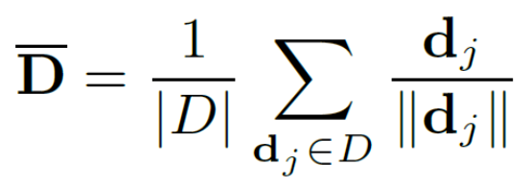
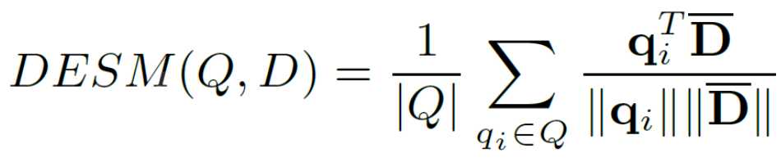
Dual Embedding Space Model (DESM)
Simple model
A document is represented by the centroid of its word vectors
Query-document similarity is average over query words of cosine similarity

Slide 47
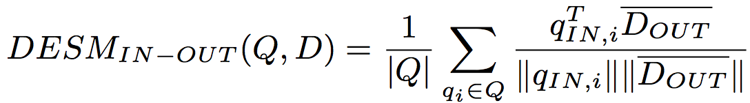
Dual Embedding Space Model (DESM)
What works best is to use the OUT vectors for the document and the IN vectors for the query
This way similarity measures aboutness – words that appear with this word – which is more useful in this context than (distributional) semantic similarity

Slide 48
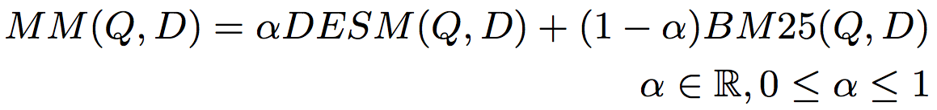
Experiments
Train CBOW from either
600 million Bing queries
342 million web document sentences
Test on 7,741 randomly sampled Bing queries
5 level eval (Perfect, Excellent, Good, Fair, Bad)
Two approaches
Use DESM model to rerank top results from BM25
Use DESM alone or a mixture model of it and BM25

Slide 49
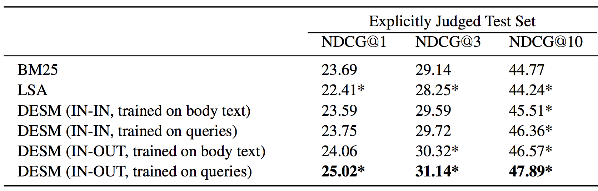
Results – reranking k-best list
Pretty decent gains – e.g., 2% for NDCG@3
Gains are bigger for model trained on queries than docs

Slide 50
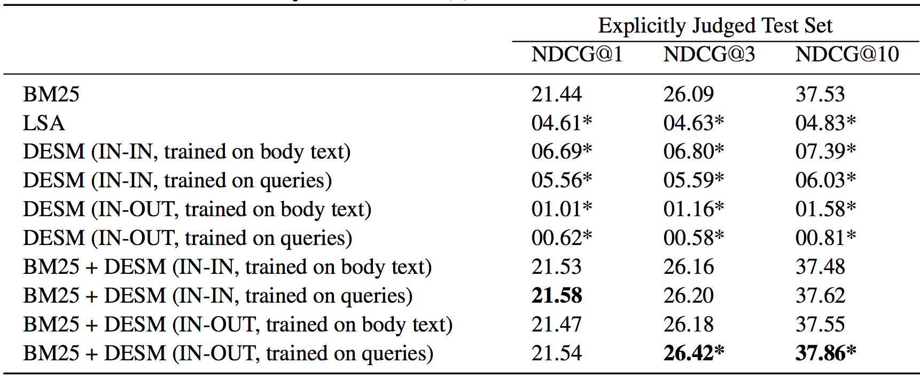
Results – whole ranking system
Notes:
Doesn’t work. Nor does LSA.

Slide 51
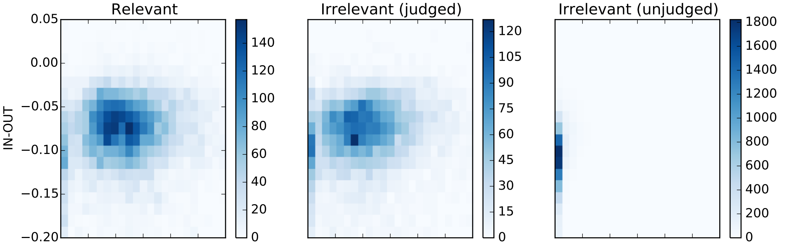
A possible explanation
IN-OUT has some ability to prefer Relevant to close-by (judged) non-relevant, but it’s scores induce too much noise vs. BM25 to be usable alone

Slide 52
DESM conclusions
DESM is a weak ranker but effective at finding subtler similarities/aboutness
It is effective at, but only at, ranking at least somewhat relevant documents

Slide 53
Summary: Embed all the things!
Word embeddings are the hot new technology (again!)
Lots of applications whenever knowing word context or similarity helps prediction:
Synonym handling in search
Document aboutness
Ad serving
Language models: from spelling correction to email response
Machine translation
Sentiment analysis
…

